Slide 1
Self Portrait in a Box
Time capsule project

Slide 2
Self Portrait in a Box
For this project you will be creating a self portrait in a sense without actually drawing a self portrait.
Instead, you will be drawing objects and your hands holding objects that represent you in different ways.
You will take these drawings and make it appear that these objects are being placed into a box or time capsule.

Slide 3
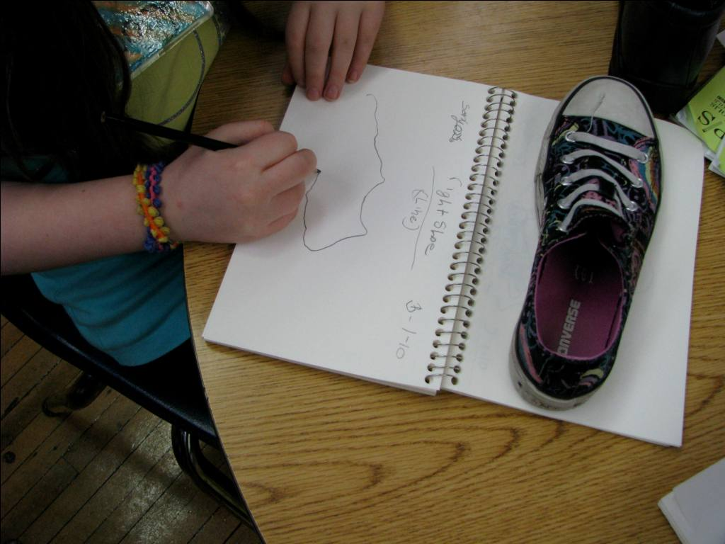
Observational Drawing
For this project you will practice drawing from life.
This means your drawings are not done from photographs or imagination, but from real life observation.

Slide 4
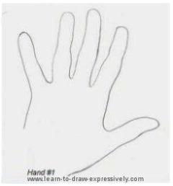
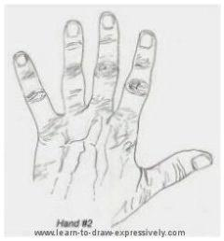
Contour Line Drawing
Drawings that define the outline and edges of the subject along with the important details that lay within the subject.
Contour line drawings do not include shading.

Slide 5
Scale and Proportion
Scale refers to the size of an object in relationship to another object. In art, the size relationship between an object and the human body is significant.
Proportion refers to the relative size of parts of a whole (elements within an object). We often think of proportions in terms of size relationships within the human body.

Slide 6
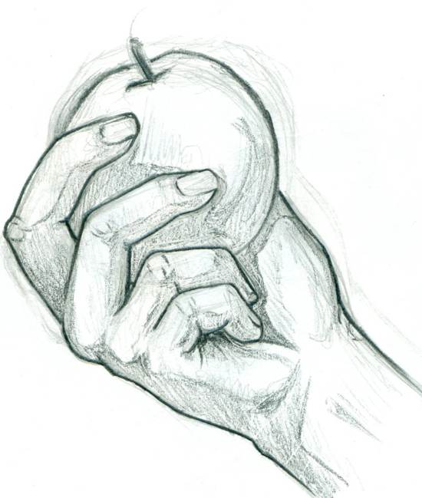
Scale
The Scale of the contour line drawings should be around life size.
You will need to pay attention to the proportion (or the size) of the fingers and the object your are holding in relation to the hand.

Slide 7
Scale and Proportion
The Scale of the contour line drawings should be around life size.
For Proportion you will need to pay attention to the size of the fingers and the object your are holding in relation to the hand as a whole.

Slide 8
Self Portrait in a Box Project
You will need to bring in six objects that are meaningful to you or symbolize something that is important to you. These items need to be small enough to be handheld.
You will then create contour line drawings of the objects using pencil on a sheet of 12”x18” piece of paper. These drawings need to be approximately life size and show detail.
3 contour line drawings of your hands holding objects
3 contour line drawings of objects by themselves

Slide 9
Self Portrait in a Box Project
After you have finished drawing your objects and your hands holding the objects you will trace your drawings using ultra-fine point sharpies.
You will then draw your box shape, go over it in ultra-fine point sharpie, and cut it out. The box will need to be big enough to fit your objects and your hands holding your objects with little overlapping. The sides of the box drawing can be decorated.

Slide 10
Self Portrait in a Box Project
You will then cut out your contour line drawings of your objects and your hands holding objects, arrange them in your box drawing, and then glue them down.
You will then mount everything onto construction paper leaving a colored border around your drawing.
You will finish your project by writing 3 sentences about each of the objects you chose and what meaning they have for you in the construction paper border space.

Slide 11
Self –Portrait in a Box

