Slide 1
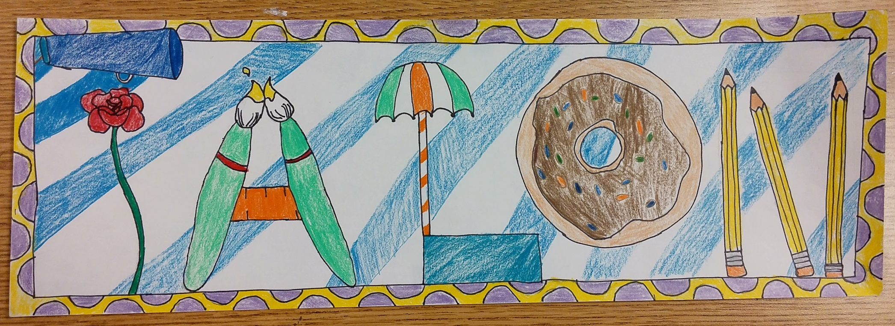
Name Transformation Project

Slide 2
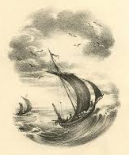
Name Transformation Project
For this project you will be taking the letters in your name and transforming them into different objects that represent you and your interests. You will present your artwork in a way that shows good creativity, craftsmanship, and composition while having all of the required content.

Slide 3
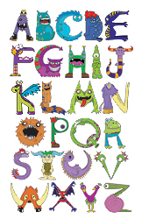
Name Transformation Project
Creativity – you must creatively transform the letters in your name into objects that represent or relate to you or have some meaning to you.
You will show creativity by: the objects you chose, what the objects communicate about you, how the objects are combined, not repeating ideas, using a limited amount of logos, and showing good detail.

Slide 4
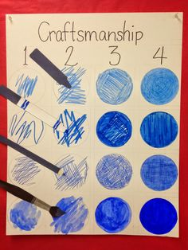
Name Transformation Project
Craftsmanship: you used good craftsmanship and showed care in creating your artwork.
-Started the Drawing with light pencil lines, traced drawings in sharpie, used rulers to make straight lines, and practiced quality coloring.

Slide 5
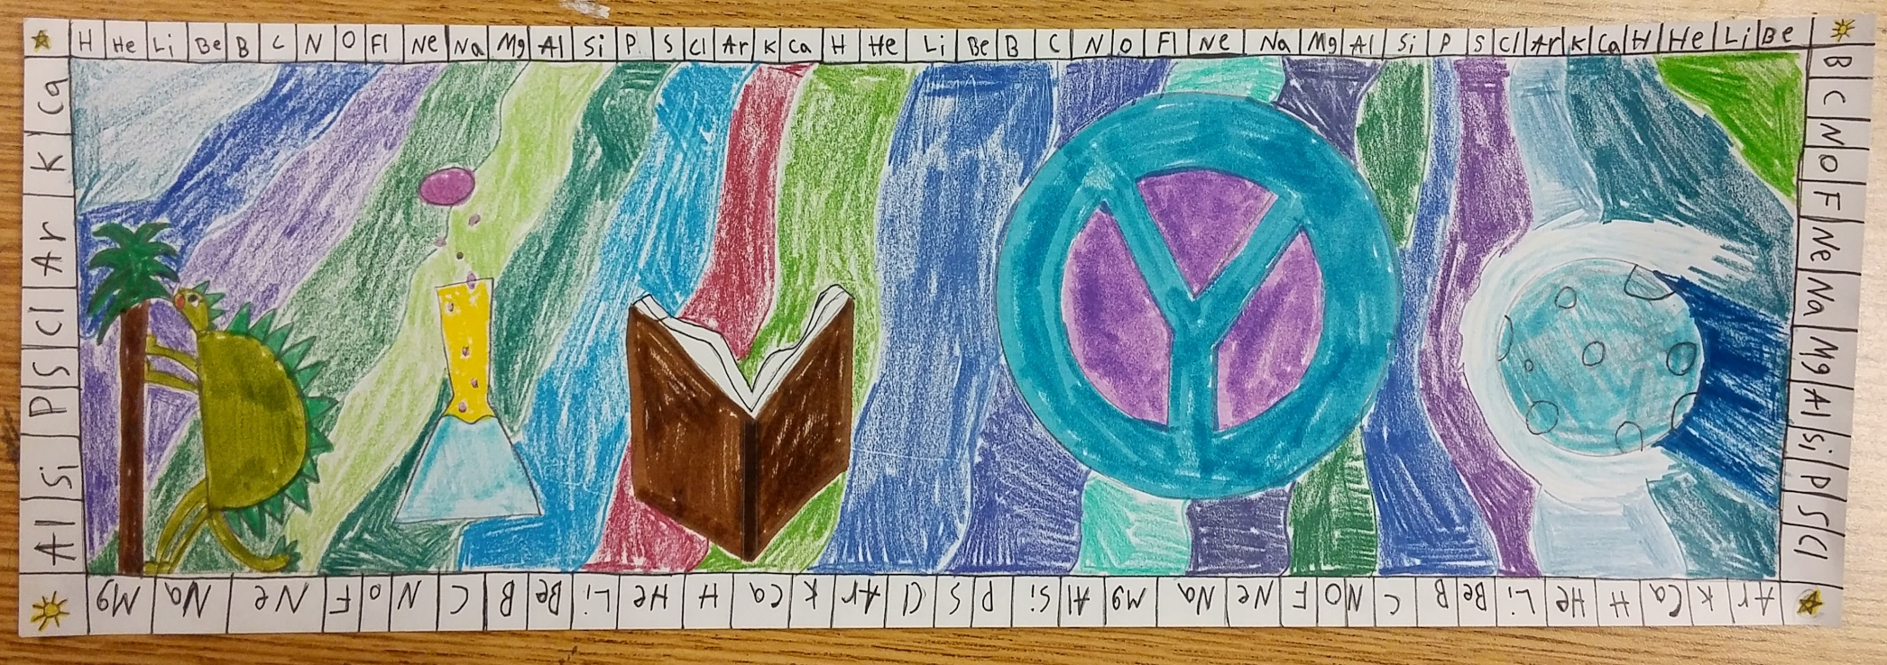
Name Transformation Project
Content: At least 5 letters have been transformed into different objects, the artwork is in full color, and there is a creative background and a border along the edges.

Slide 6
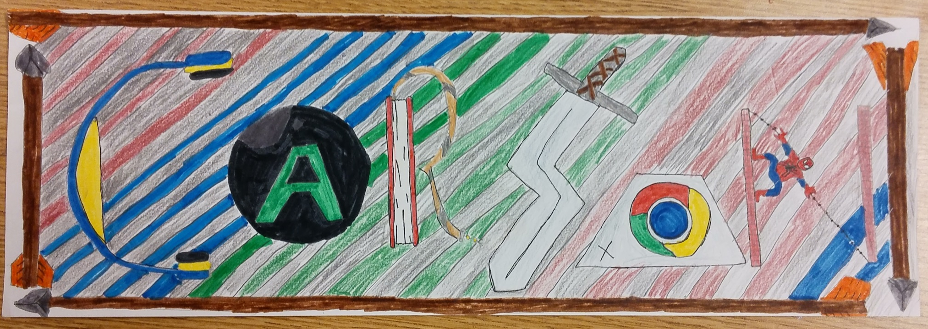
Name Transformation Project
Composition: You will create a composition that is well planned out and fits the page. Nothing is squished or crowded to help fit the page.
-Artwork is planned out so that the letters are spaced evenly on page so they are not squished at the end or you leave a lot of extra unused space.

Slide 7
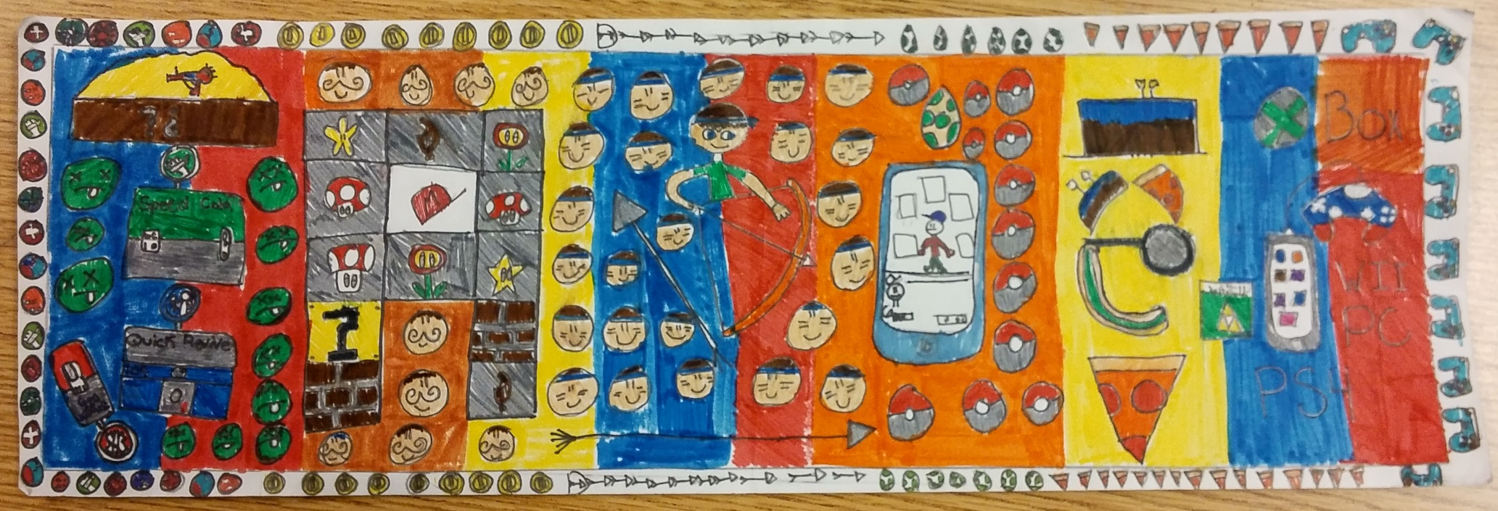
Name Transformation Project
Effort/Participation: Student will put forth their best effort, will remain on task, maintain a good attitude, and follow classroom rules.

Slide 8
Steps 1 and 2
Step 1 – fill out the brainstorming sheet with interests/hobbies/things about you along with things and objects that relate to your interests and hobbies.
Step 2 – do a planning sketch in your sketchbook before you begin on your final piece.

