Slide 1
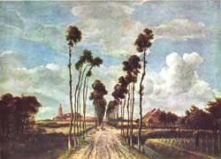
Perspective Drawing
One-Point Perspective

Slide 2
Perspective
During the Renaissance artists became interested in making two-dimensional artwork look three-dimensional.
Renaissance- (1450-1600): The Renaissance began in Italy and spread through Northern Europe. Art, Science, and Literature grew during this time.

Slide 3
Perspective
Many of the earlier works artists created showed little depth.
Does this picture reflect depth? Why or why not?
How could this picture be changed to increase its’ depth?
Kaufmann Haggadah. Spain, late 14th C.

Slide 4
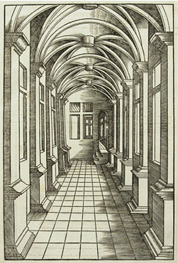
How do we create the illusion of three dimensional space on a two dimensional surface?

Slide 5
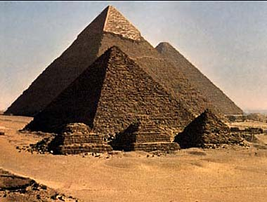
How do we create the illusion of space on a two dimensional surface?
Overlapping
Giving objects form-shading
Notes:
We see that the pyramids closest to us are in front of the pyramids in the back.

Slide 6
How do we create the illusion of space on a two dimensional surface?
Objects that are closer are larger
Objects that are farther away are smaller

Slide 7
How do we create the illusion of space on a two dimensional surface?
Objects that are closer are lower on the page.
Objects that are farther away are higher on the page.

Slide 8
How do we create the illusion of space in a two dimensional work of art?
Everything appears to recede into the distance at the same rate, converging, or coming together, at a single point at the horizon.

Slide 9
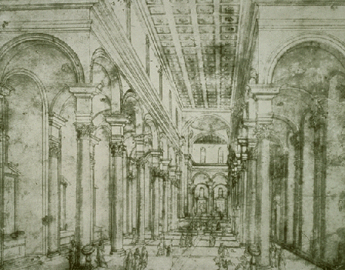
Pictorial Space
The illusionary space in a painting or other two-dimensional art that appears to recede backward into the picture.
Perspective drawing for Church of Santo Spirito in Florence
Artist: Filippo Brunelleschi
Completion Date: c.1428
Place of Creation: Italy
Style: Early Renaissance
Notes:
This method, known as mathematical, linear or Renaissance perspective, was first demonstrated by Filippo Brunelleschi around 1413-1420. Through a series of visual experiments, including tracing reflections on mirrors, he developed his theories and understanding of perspective drawing.

Slide 10
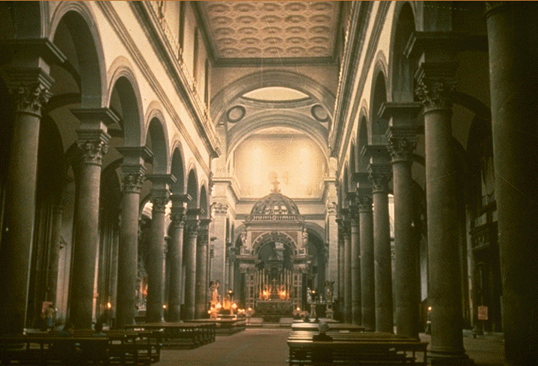
Church that was built from the drawing
Drawing
Notes:
All of the lines converge at a single point that is at about his eye level. As the pillars go back they appear to get smaller and closer together. They also ovelap.

Slide 11
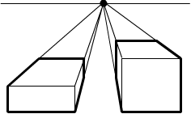
Linear Perspective
A form of perspective in drawing and painting
in which parallel lines are represented as
converging, or coming together, so as
to give the illusion of depth and distance.

Slide 12
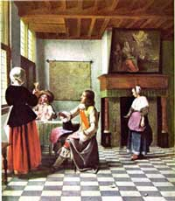
Linear Perspective
Artists used mathematics and close observation to invent linear perspective.
Linear perspective allows artists to trick the eye into seeing depth on a flat surface

Slide 13
Linear Perspective
Linear Perspective:
Based on the way the human eye sees the world.
Objects that are closer appear larger, more distant objects appear smaller.
To create the illusion of space, the artist creates a vanishing point on the horizon line.
Objects are drawn using converging lines, which lead to the vanishing points.

Slide 14
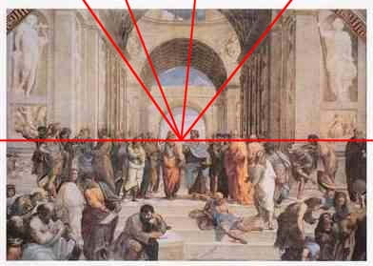
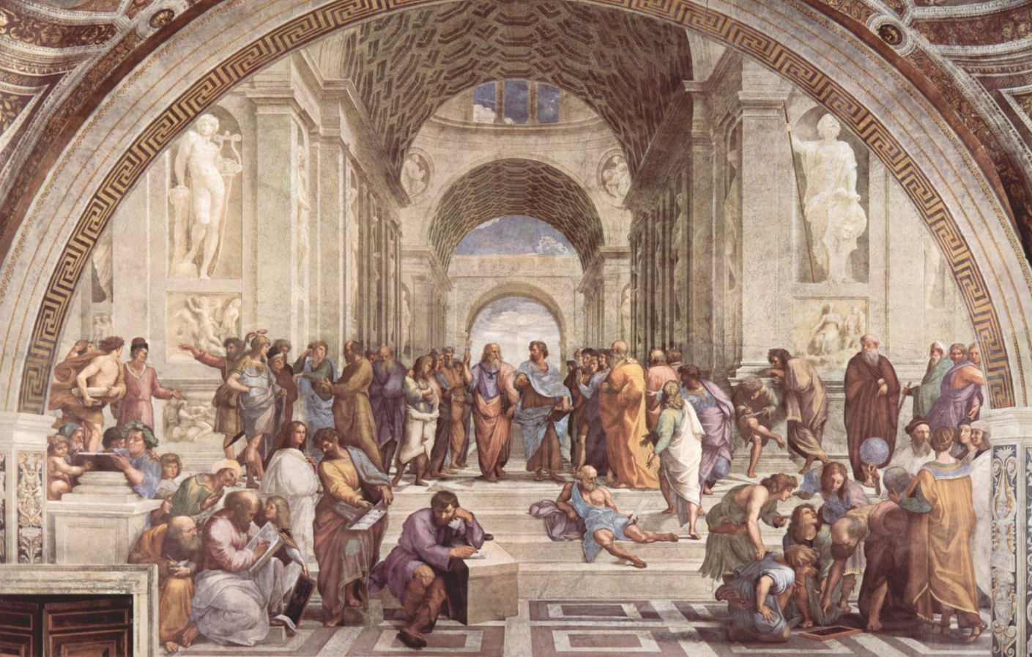
One-Point Perspective
One-point linear perspective: A version of linear perspective in which there is only one vanishing point in the composition.
The School at Athens
Raphael, 1510-1511

Slide 15
One Point Perspective Vocabulary
Picture Plane: the canvas or piece of paper the painting or drawing is on
Horizon Line: represents the viewer’s eye level
Converging Lines: (aka vanishing lines) two or more imaginary lines that get closer and closer towards the vanishing point. Used to create accurate linear perspective .
Vanishing Point: the point in linear perspective at which all converging lines of perspective meet.

Slide 16
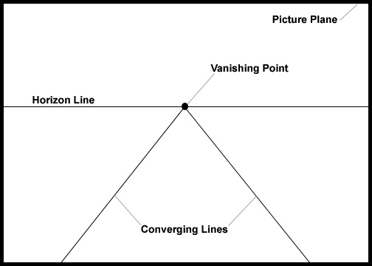

Slide 17
Lets look at the train tracks again.
Notes:
We know that the train tracks in reality are parallel to each other, but due to the way we see they seem to converge at a single point creating the appearance of space.

Slide 18
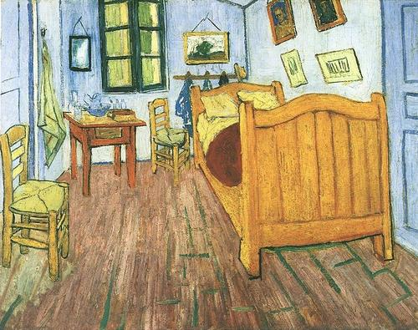
One Point Linear Perspective
Can you find the vanishing point in this picture?
How did you determine this?
Can you locate the Horizon Line?
Bedroom in Arles
By Vincent Van Gogh
1889

Slide 19
VANISHING POINT
HORIZON LINE
CONVERGING LINES

Slide 20
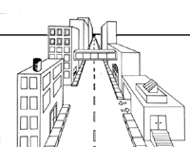
One Point Linear Perspective
Artists use one-point perspective to show objects face-on.
Most lines are vertical, horizontal, or diagonal drawn to converge on a single vanishing point.

Slide 21
Perspective
The Horizon Line is horizontal, it goes from left to right and is parallel to the bottom edge of the picture.
Represents the viewer’s eye level.
It is the place where the ground and the sky seem to meet
You can see the top of an object if it is below eye level, below the Horizon Line.
If an object is above eye level, above the Horizon Line, you can not see it’s top.

Slide 22
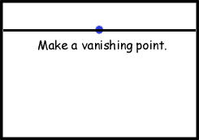
Perspective
Place a dot in the middle of the Horizon Line. This is your vanishing point. In one-point perspective the Vanishing Point, represented is always on the Horizon Line. As things get closer to the Vanishing Point they get smaller and smaller until they appear to vanish.

Slide 23
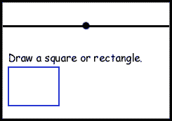
Perspective
Draw a square or rectangle In your picture plane.

Slide 24
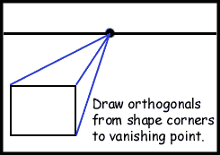
Perspective
Now connect three corners of your rectangle or square to the vanishing point. These are the converging lines.

Slide 25
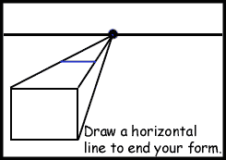
Perspective
Draw a horizontal line between the two diagonal converging lines
where you want your forms to end.

Slide 26
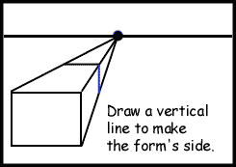
Perspective
Vertical lines go from the top of the page to bottom of the page and are perpendicular to the bottom edge of the picture. Along with diagonal converging lines and horizontal lines they make up a one-point perspective drawing.

Slide 27
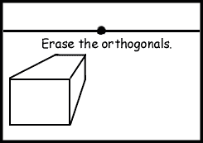
Perspective
Erase the converging lines to complete your form. You now have a 3-D form in one-point perspective.

Slide 28
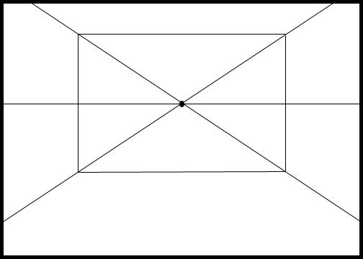
Demonstration
Draw Horizon line and vanishing point.
Using vertical and horizontal lines, draw your back wall.
Then draw converging lines that meet at your vanishing point and go through the corners of your back wall. These are the left and right walls.

Slide 29
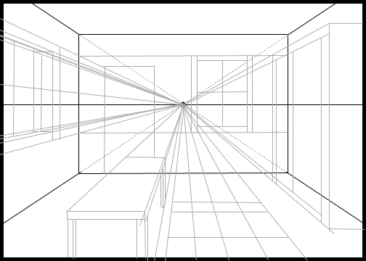
Demonstration
Using light lines, draw in your furniture and the other details of the room.
You can see the top of an object if it is below eye level, or below the Horizon Line. If an object is above eye level, above the Horizon Line, you can not see its top.

Slide 30
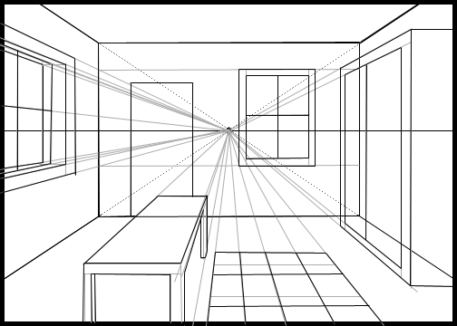
Demonstration
Darken in the edges and add color.

Slide 31
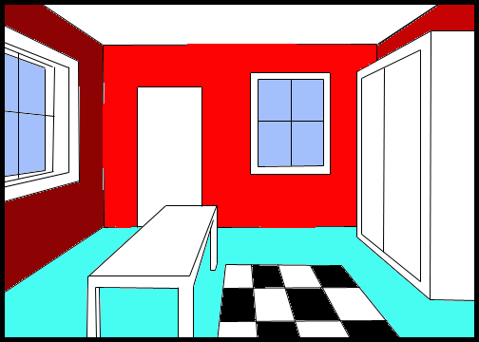
Demonstration
Darken in the edges and add color.

Slide 32
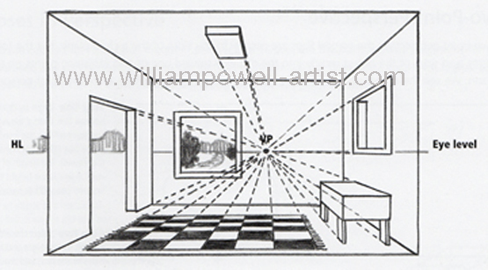

Slide 33
Creating My Perfect Room
Using one-point linear perspective, design and draw your perfect room.
Have the room reflect your personality and interests.
This room can be real or imagined.
Is it your man cave, bedroom, hunting trophy room, kitchen, workspace, classroom or walk in closet?
Is it your room on the space station?
What type of furniture, flooring, lighting, curtains, trim, windows, doors, and artwork does your room have?
Remember to use other techniques we discussed, like having objects overlap, to create pictorial space.
This drawing must be colored in using colored pencils.

Slide 34
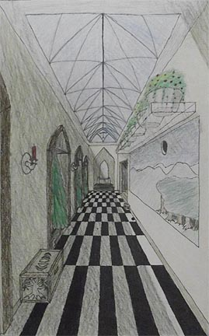
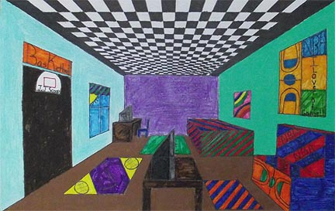
Examples

Slide 35
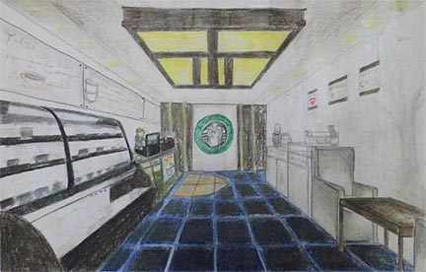
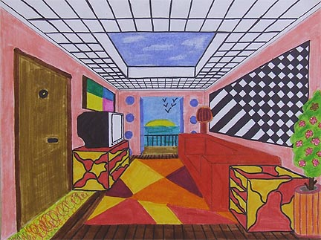

Slide 36
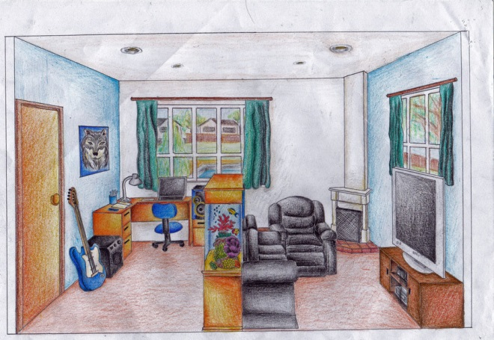
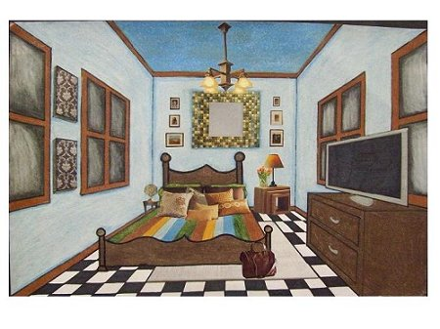

Slide 37
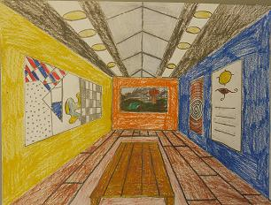
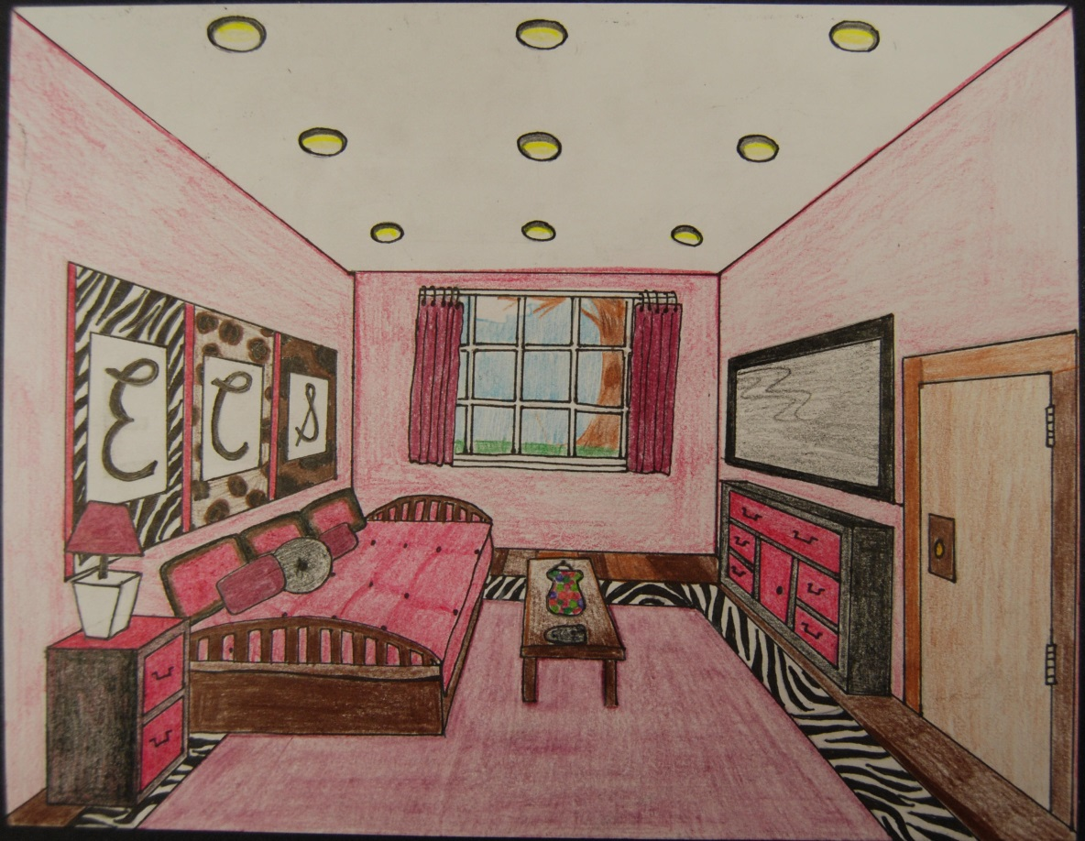

Slide 39
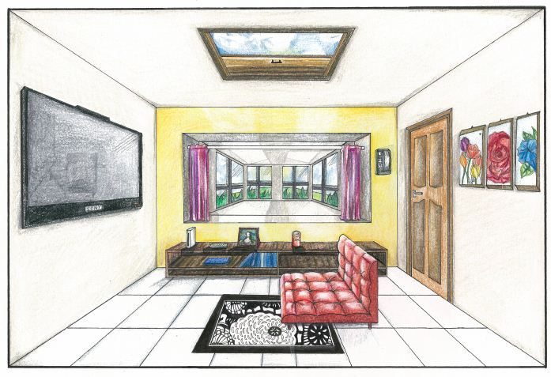

Slide 40
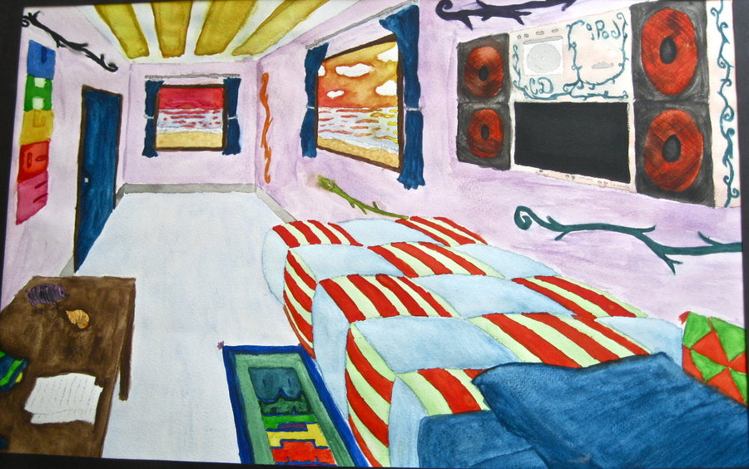

Slide 41
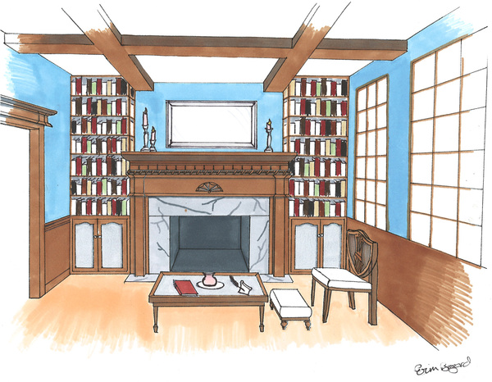
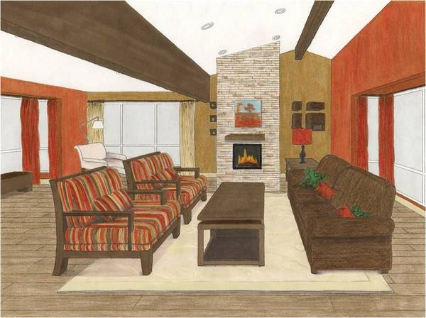

Slide 42
